Slide 1

DEPARTMENT OF COMPUTER ENGINEERING
Stock Management System
Roll No: 03
Roll No: 06
Roll No: 17
Student name: Vihang Patil
Student name: Kunal Saini
Student name: Bhavesh Pawar
Under the Guidance of : - Prof.Tanvi Kapadi

Slide 2
Problem statement
The problem with the current stock management system is that it is manually recorded by staff, which can lead to errors, inefficiencies, and delays in restocking when inventory is low. There is a need for a more efficient and automated system that can accurately track and manage inventory in real-time, while also providing data insights to optimize inventory levels and reduce costs.
Additionally, the lack of a reliable and scalable technology infrastructure for the stock management system limits the potential for growth and efficiency, which can be addressed by leveraging the cloud-based services and tools provided by AWS.

Slide 3
Objective
To design and develop a user-friendly system that handles the information of items or products, supplier, and lab calculated it to manage the information system
To develop an application that deals with the day-to-day needs of any production college.
To help the lab administrator to communicate with the stock administrator with efficiency.
To help the user to know which pc is working or which is not.

Slide 4
Scope
The Stock Management System (SMS) is targeted at schools and colleges. This system focused on calculating the amount of stock in and out for a college from the stock lab. The scope user for this system is administrators and staff.
Admin can Login, manage update and view stock in the stock lab, manage reordering process and update or delete. Have full privileges for adding, editing, viewing, and deleting items in stock, supplier details, and lab details from the system.
Lab Administrator can have privileges to edit or delete lab details, edit pc details, and upload timetable.
System is web application targeted for schools and colleges to fully utilize the functionality.

Slide 5
Description
EC2: Amazon Elastic Compute Cloud (EC2) is a web service that provides resizable compute capacity in the cloud. It allows users to quickly and easily provision virtual machines and deploy applications on the AWS cloud.
Elastic IP: Amazon Elastic IP (EIP) is a static, public IPv4 address that can be associated with an instance or a network interface in a particular AWS account.
IAM: AWS Identity and Access Management (IAM) is a web service that enables you to manage access to AWS services and resources securely. IAM allows you to create and manage users and groups, and assign permissions to control their access to AWS resources.
Route 53: Amazon Route 53 is a scalable domain name system (DNS) web service that enables you to manage domain names and route internet traffic to your application.

Slide 6
Deploying website on AWS

Slide 7
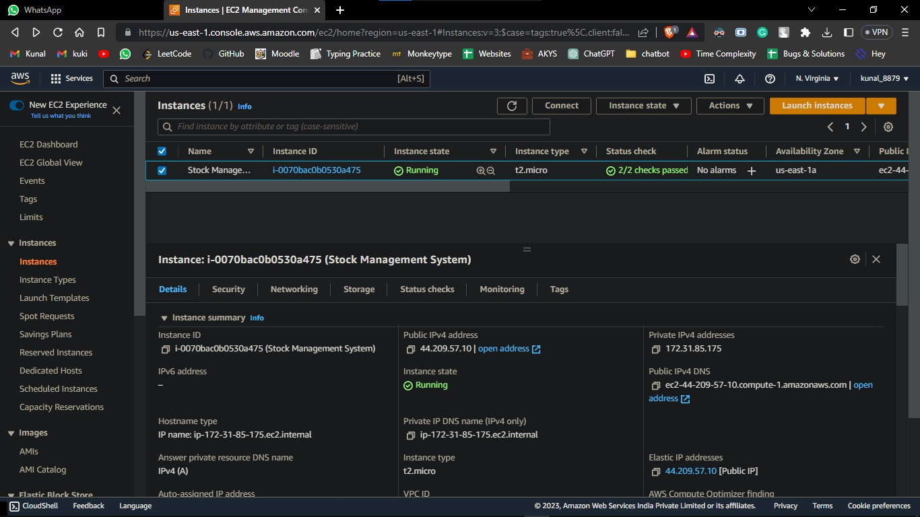
E2C:

Slide 8
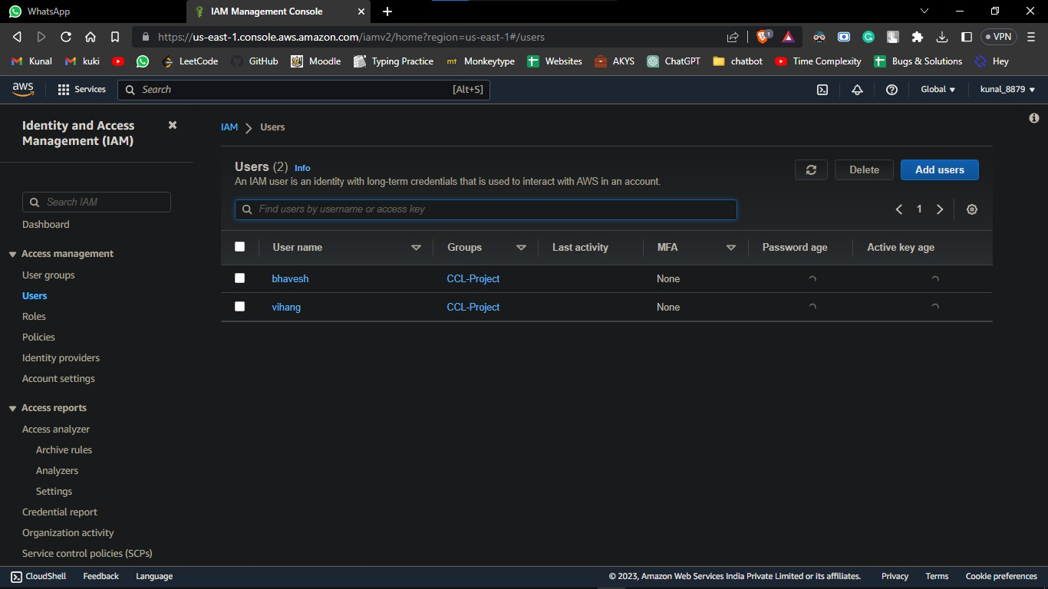
IAM:

Slide 9
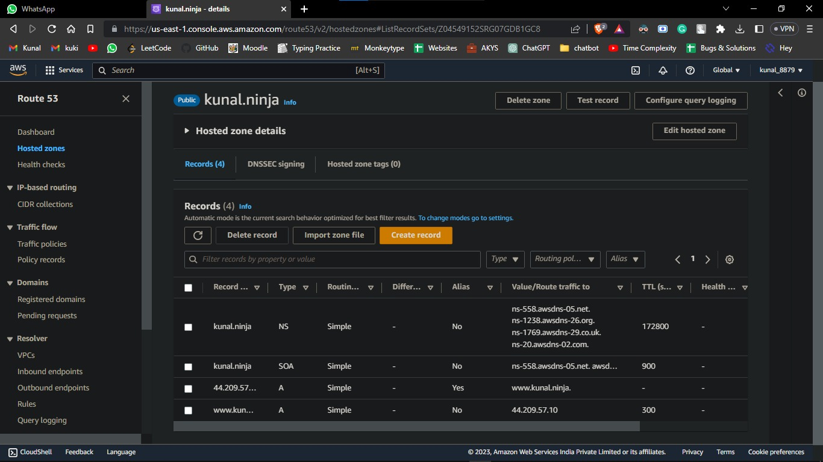
Route 53

Slide 10
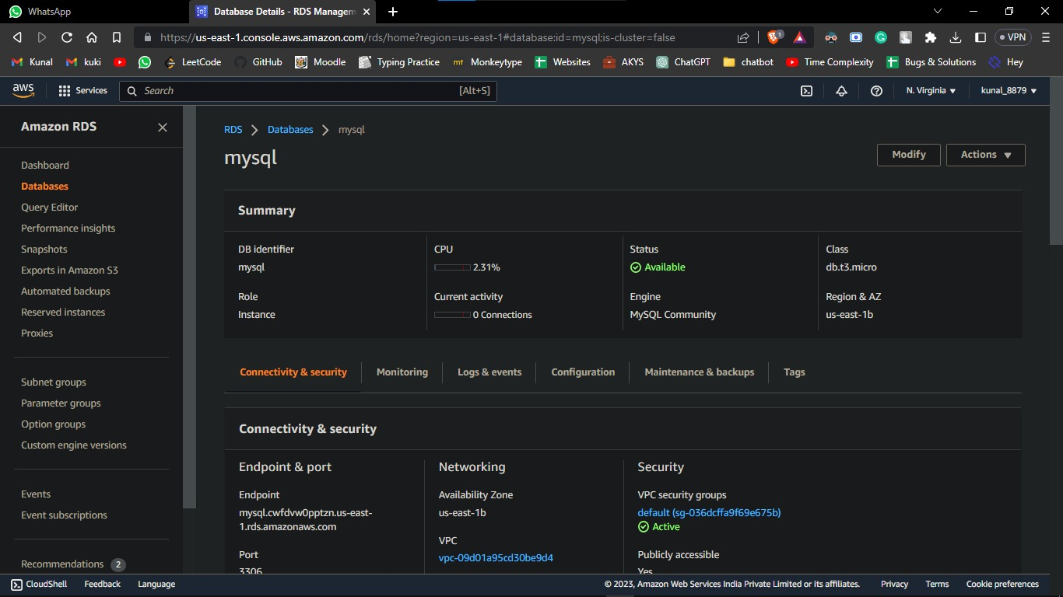
RDS:

Slide 11
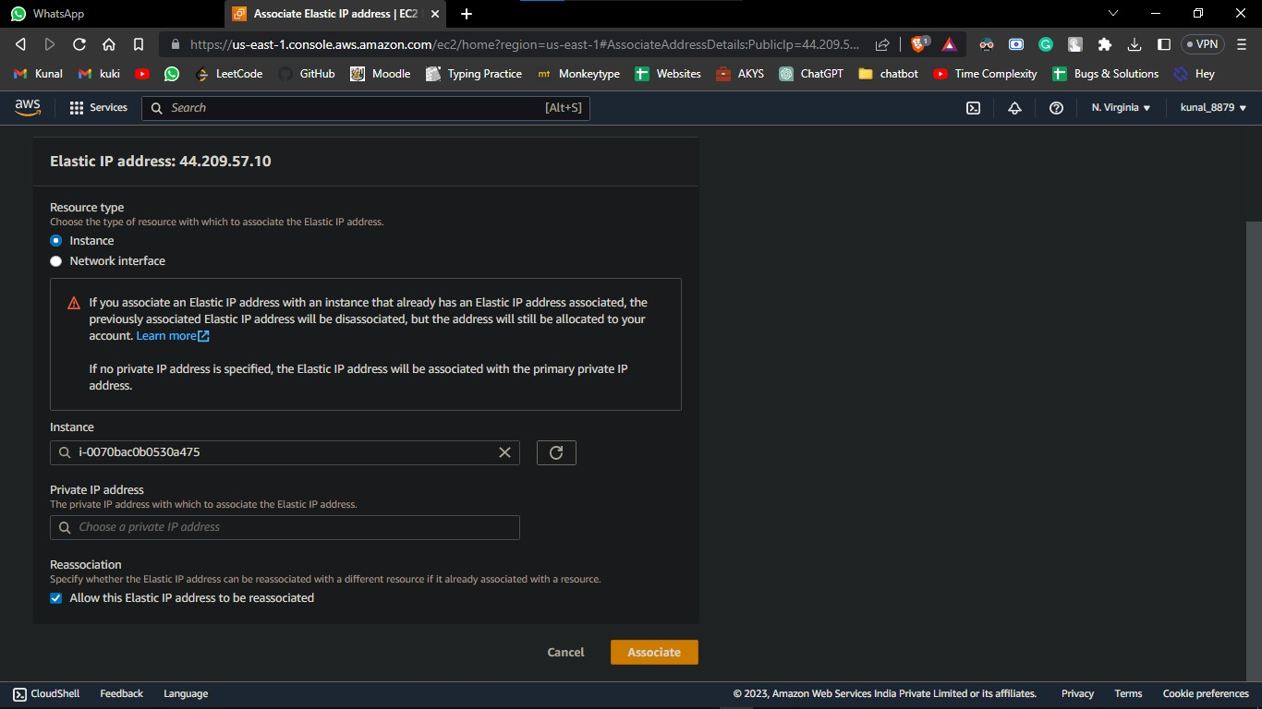
Elastic IP:

Slide 12
THANK YOU

